Slide 1
Data Preprocessing

Slide 2
Index
Importing Necessary Libraries
Reading datasets into a DataFrame
Handling Missing Data
Encoding Categorical Data
Splitting Dataset Into Training And Testing
Feature Scaling
Demo

Slide 3
Importing Necessary Libraries
Numpy:
It has support for large, multi-dimensional arrays and matrices, along with a large collection of high-level mathematical functions to operate on these arrays.
Pandas:
It is used to read data frames and helps us with other data manipulations.
Matplotlib:
It is used for data visualisation.

Slide 4
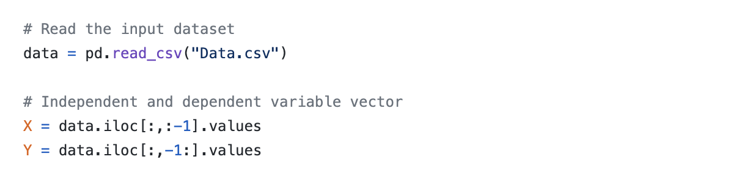
Reading datasets into a DataFrame
pd.read_csv(“INPUT DATA FILE”) is used to read the dataset into a DataFrame
dataset.iloc[: , : -1] extracts necessary columns into the DataFrame
.values part is used to convert it into a bumpy array

Slide 5
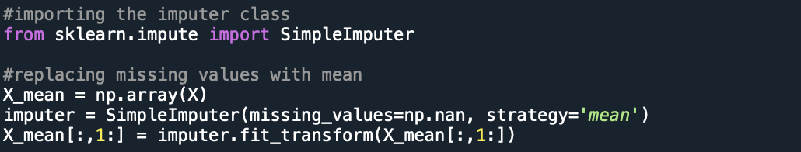
Handling Missing Data
First we are copying the numpy array into another array.
Then we are creating an instance variable of SimpleImputer Class by selecting the strategy like mean, median, most_frequent.
Then we are fitting and transforming the data into our dataset.

Slide 6
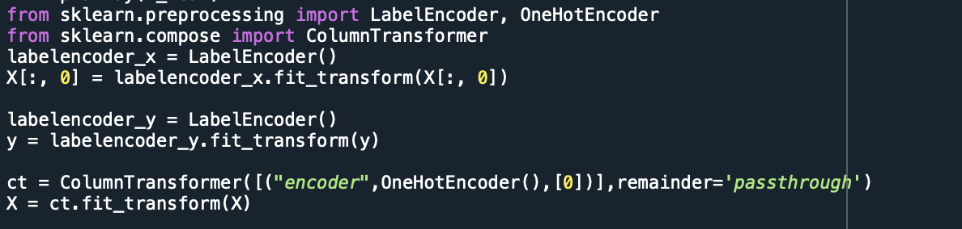
Encoding Categorical Data
We create a LabelEncoder object to convert categorical data into integer data.
We use ColumnTransformer to convert the numeric data into binary data so as to give equal priority to every value.

Slide 7
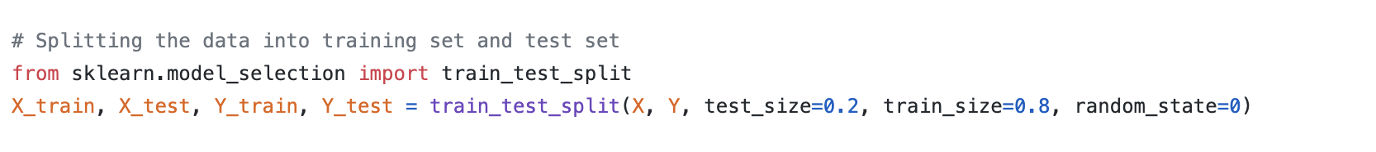
Splitting Dataset in Training and Testing
We split the dataset into testing and training set as we train on a portion of the data and test our results with the other portion of the data.

Slide 8
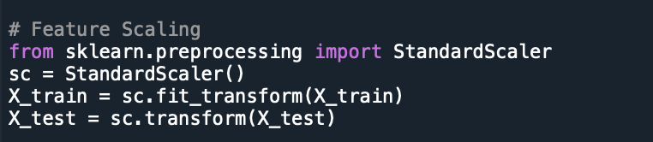
Feature Scaling
Here, we normalise the values as we don’t want to prioritise a column while training the values w.r.t. a model.

Slide 9
Demo

Slide 10

THANK YOU

